Slide 1
ES6 and Fundamentals of Web Development
CS-554 – Web Programming

Slide 2
Course Technologies

Slide 3
Our Tech Stack
By default, we will be starting with the Node, Express, Mongo tech stack
Direct continuation of Web 1 web stack, with tons more!
Most instructions will assume a Mac OS X operating system in this course.

Slide 4
Recommended Operating Systems
Windows is not a recommended operating system for this course, and Mac OSX will be the assumed OS in all instructions due to it being the ideal web development environment.
If you do not have a Mac system, you can emulate it using VirtualBox
https://techsviewer.com/how-to-install-mac-os-x-el-capitan-on-pc-on-virtualbox/

Slide 5
Node Version
In this course, we will be using Node for our server side language. You should install the most recent current version of Node for this course.
https://nodejs.org/en/download/current/
You may find it easier to install with NVM to maintain many versions of node
https://github.com/creationix/nvm
https://github.com/coreybutler/nvm-windows

Slide 6
Mongo DB
For most scenarios, we will be using MongoDB for the de facto database of choice.
https://www.mongodb.com/download-center#community
It is an easy, simple, key-value database.

Slide 7
Redis
Later on in the course, we will be using Redis.
https://redis.io/
I implore you to install this now and early and experiment with it.

Slide 8
ES6
Changes to the JavaScript Language

Slide 9
What is ES6?
ES6 is the most recent spec of what constitutes the JavaScript language. It is, at this point, mostly adopted on the Node side.
ES6 provides a series of very large conveniences, especially with easier asynchronous code handling.

Slide 10
What is async / await?
Handling asynchronous code often leads to massive lines of confusing promises, or fiendishly long callback chains.
In order to eliminate this, ES6 introduces a syntax for unraveling a promise, known as async and await.
This is, single handedly, the best thing to happen to the language since its creation.

Slide 11
What does async mean?
You can now define a function as an “async” function. This means that the function body will automatically be wrapped in a promise, and will return a promise (even if, syntactically, it just returns a value without any async code).
Async functions have the benefit of being able to await promises (and, therefore, other async functions).
Async functions are the only types of function that can await promises.

Slide 12
What does awaiting do?
Using the await keyword will, syntactically, not execute the next line of code until the promise has been resolved or fulfilled. This is syntactic sugar only. In actuality, the code below that await is unraveled and placed in a .then callback for the awaited promise.
As a result, you can now write async code that appears to be written synchronously.
As a secondary result, you can now simply use try / catch around your async code and catch errors that way.

Slide 13
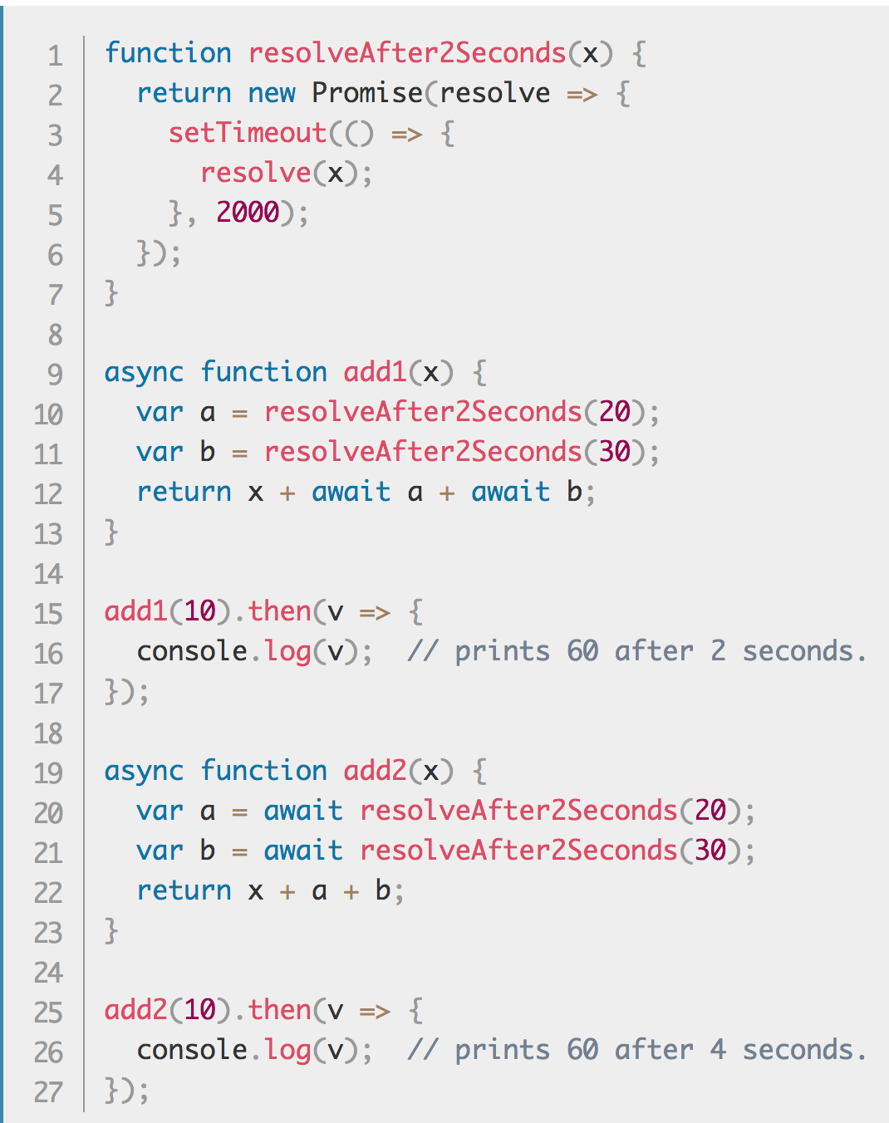
Example
Remember, we can only await inside async functions.
https://developer.mozilla.org/en-US/docs/Web/JavaScript/Reference/Statements/async_function

Slide 14
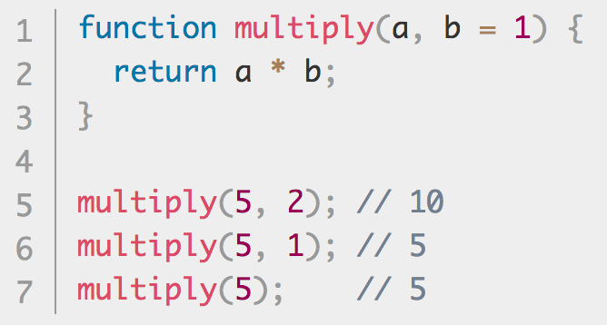
Default Parameters
Now, we can set default values to our parameters. If a parameter is undefined, it will take on the default value.
https://developer.mozilla.org/en-US/docs/Web/JavaScript/Reference/Functions/Default_parameters

Slide 15
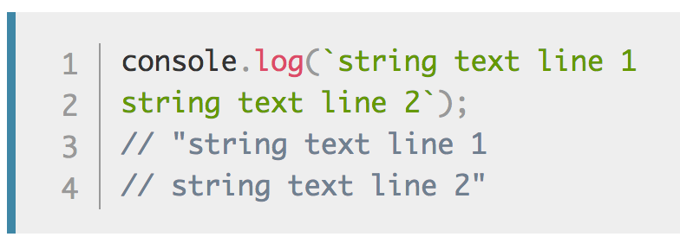
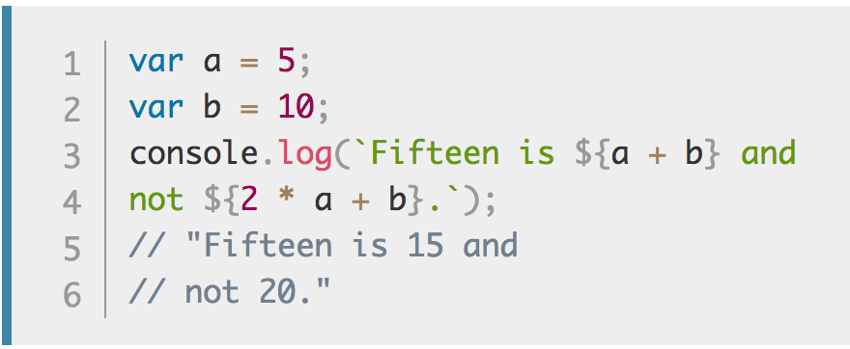
Template Literals / String Interpolation
Rather than concatenating strings like barbarians, we can now just interpolate our strings.
We can also make multine strings in the same format. Finally.
https://developer.mozilla.org/en-US/docs/Web/JavaScript/Reference/Template_literals

Slide 16
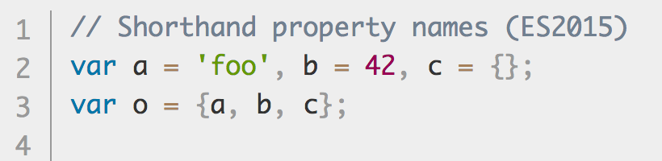
Object Literal Shorthand
Gone are the days of defining an object that uses the same key name as variable names, and writing it twice!
https://developer.mozilla.org/en-US/docs/Web/JavaScript/Reference/Operators/Object_initializer

Slide 17
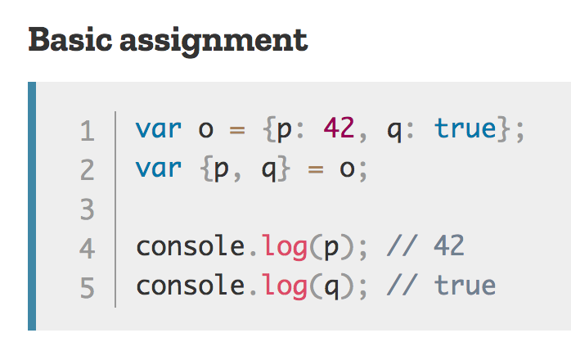
Destructuring Objects
Conversely, we can now go from ”object with these 5 properties” to “these 5 variables”
https://developer.mozilla.org/en-US/docs/Web/JavaScript/Reference/Operators/Destructuring_assignment

Slide 18
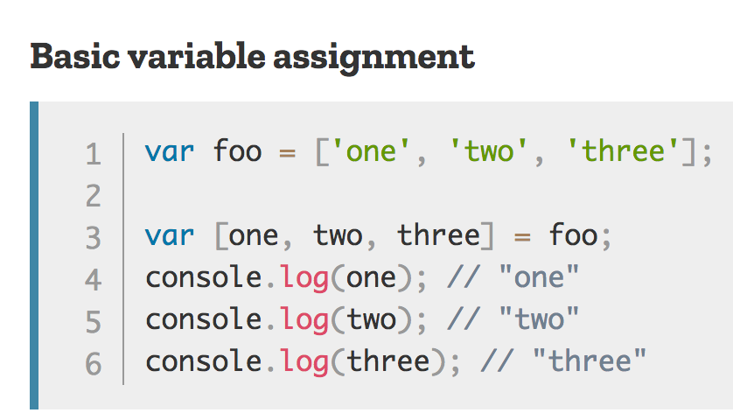
Destructuring Arrays
Similarly, arrays work the same way.
https://developer.mozilla.org/en-US/docs/Web/JavaScript/Reference/Operators/Destructuring_assignment

Slide 19
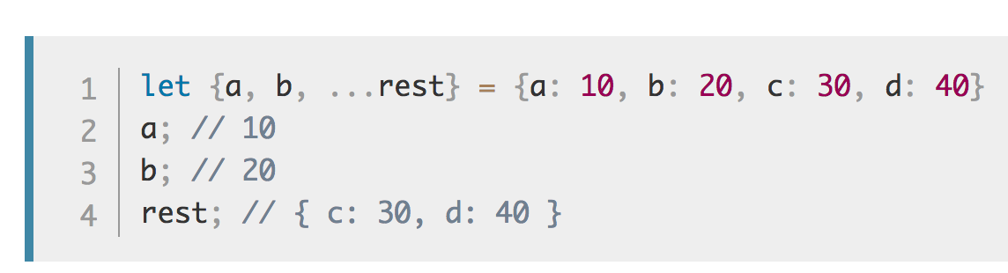
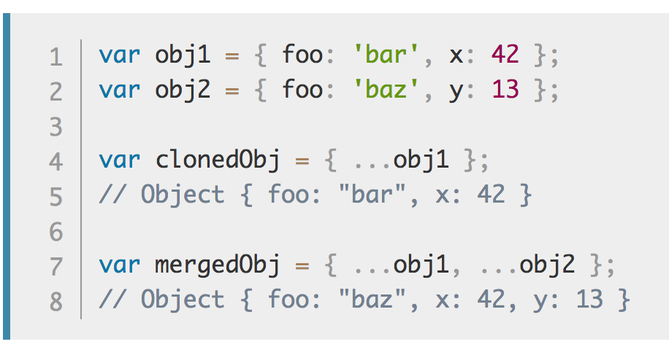
Object Spread
While destructuring, we can also spread an object and create another object with those keys.
This also makes for good shallow cloning, as well. It is not a deep clone operation. You can shallow-clone an object by using the spread operator without other parameters, or you can override
https://developer.mozilla.org/en-US/docs/Web/JavaScript/Reference/Operators/Spread_operator

Slide 20
Web Development Recap

Slide 21
Intro to JavaScript and Node
Lecture 1 – Web 1

Slide 22
Some basic facts about JavaScript
JavaScript is a loosely typed language, a concept that you may have seen before.
Loose typing means that you don’t strictly declare types for variables, and you can change the type of data that that you store in each variable.
There are five primitives currently, with a sixth (Symbol) on the way
Boolean
Number
String
Null
Undefined
JavaScript also has Objects, which all non-primitives fall under
Functions in JavaScript are types of Objects
Objects are prototypical

Slide 23
Functional Scope in JavaScript
Functions are one of the most fundamental building blocks of JavaScript.
We often want to isolate our scope in JavaScript, particularly when we write browser-based JavaScript code in order to avoid conflicts between libraries.
While Node.js scripts isolate their variables between files, all top-level variables in a browser-environment become global variables, even across different files.
In JavaScript, scope is not defined by block unless using the keyword let to define a variable; when using var, it is defined by the function you are in.
http://coffeegrammer.com/understanding-functional-scope/

Slide 24
JavaScript resources
Most of the JavaScript language can be learned from two simple guides; the MDN and the Node manual.
The Node Manual contains all information on JavaScript in the Node environment
https://nodejs.org/api/
General and front-end based JavaScript can be found on the MDN
https://developer.mozilla.org/en-US/docs/Web/JavaScript/Guide

Slide 25
MongoDB
Lecture 4

Slide 26
What is a database?
A database is an organized collection of data. It allows you to create, read, update, and delete data. Unlike storing in memory, databases allow you to persist your data.
MongoDB is a document-based database.
Document-based databases store semi-structured data (think, JSON!) and only lookup by key (a unique identifier)
You interact with MongoDB by submitting queries to your database that describe operations that you wish to do.

Slide 27
What is a document-based database?
Traditional databases are stored in tables that are composed of columns describing data and rows of data. They have a pre-defined schema to them, constraining the type of data you can make in each table.
Document-based databases forgo this, and allow you to simply store and retrieve data at a particular location. They are very good at ID lookups, but suffer slightly on querying.
This is less off an issue now than in previous years.

Slide 28
The structure of MongoDB
MongoDB only has a few layers to it:
Databases: You can create a database to contain related collections
Collections: Each database has a number of collections. Collections are sets of documents that you decide are related by their content. Your documents do not have to have the same fields.
Documents: Documents are self contained pieces of data that you store in a collection. Each document must have an ID, and can have any other set of fields; these fields can be smaller subdocuments.
Subdocuments: A document field can describe another document that will be stored in its parent. This is akin to an object that has a second object stored as a property. This is referred to as a subdocument.

Slide 29
Abstracting Your Queries
It is often very useful to create a file to abstract away your database querying.
By creating a layer between your application code and your database, you will allow yourself to:
More easily make changes to the database later on
Allow non-database programmers to more easily use the database (separation of concerns!)
More easily improve performance at a later time
Easier and more consistent error checking throughout your entire application.
Make it a reasonable task to change your entire database when the first database your company chose ends up being unable to support large amounts of data and you need to transition over to another database.
Also helps when this happens again 2 years later.
In dogs.js we abstract the queries to hide them away from the rest of our application.

Slide 30
Basic operations in MongoDB
For now, we will be focusing on four different operations:
Insert: will take an object and insert it into the database.
Find: will take an object describing fields and values to match and returns an array of matching documents.
Update: will take two objects; one that contains an object describing fields and values to match, and one that will describe the update to perform. It can update multiple if you provide a third object with settings telling it to update multiple documents.
Remove: will take an object describing fields and values to match and will remove the object. It can remove multiple if you provide a second object with settings telling it to update multiple documents.

Slide 31
MongoDB Cheat Sheet
Most common MongoDB commands can be found on this cheat sheet
https://blog.codecentric.de/files/2012/12/MongoDB-CheatSheet-v1_0.pdf
Most MongoDB commands in the Node Driver have fairly straightforward commands.
http://mongodb.github.io/node-mongodb-native/2.2/api/

Slide 32
Fundamentals of Web Development
Lecture 5

Slide 33
The Core Process of the Web
At the end of the day, the web is all about the communication of ideas. Everything in the web can be seen as a request and a response
When you go to a news website, you’re requesting news and receiving news in response.
When you go to a shopping website, you’re requesting product information and receiving relevant information.
When your server receives input, it determines what to do with that input and outputs the proper response.
Your duty as a web developer is to make that communication possible. Your programs will get a request and give a response, and allow that communication to occur as smoothly as possible.
Notes:
The first thing we have to understand in web programming out is what actually happens when we use the web?
Everything accessible on the internet follows a very simple pattern: somebody (or something, like a program) makes a request, and a server returns a response. Most problems we will face in web programming can be seen as a sort of handshake: you will look at what data you have and know, and figure out how to turn that into what data you need it to become.
A request is some form of a question. When we go to a web page, we’re actually sending a server somewhere a request to receive some sort of data. Your job as a web programmer is to figure out how to work facilitate this communication between users and the data they want. You’re essentially acting as a translator for people to get the information that they’re looking for. The web is all about communication, even in its programming.

Slide 34
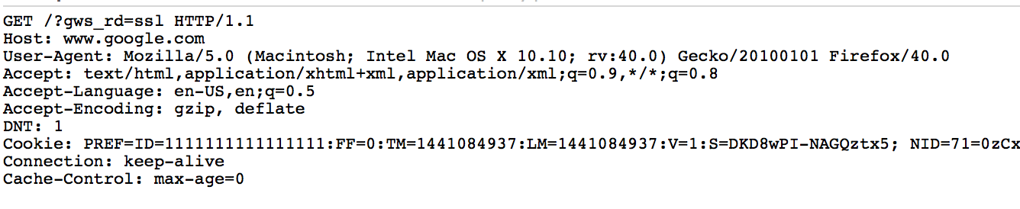
The request
Every time you navigate to a website, your browser sends a request on your behalf to the server.
There is a lot to an HTTP request! https://developer.mozilla.org/en-US/docs/Web/HTTP
Each request follows a standardized process! https://www.w3.org/wiki/How_does_the_Internet_work
Every request is formatted in a specific way, with the same data provided on each request.
A request to http://google.com/ would look like:

Slide 35
Parts of that request
HTTP Verb signifying what action you are trying to (GET POST PUT DELETE)
The server you want to connect to (the HOST)
The location of the resource you want to access on that server (the location)
Headers
Headers are metadata about your request
These include cookies!
Notes:
While we’re not actually programming in the backend yet and dealing with sending requests and receiving responses, it’s important to have an understanding of what’s inside of a request. Keeping this in the back of our minds will make things much easier later on down the line.
When a user navigates to a url, the browser composes a request to send to a server on the user’s behalf. This request has a bunch of data, such as what page the user is asking for, what type of content the user expects to get back, and other data such as cookies that the server may have sent to the user.
On the right side of this slide, I’ve included a request from my computer to Google’s home page.

Slide 36
Status Codes
Each response must return a status code indicating whether or not the request was successful, and a description is often included with each of the status code
Status codes in the...
200-299 range indicate a successful operation
300-399 range indicate some sort of redirection must occur
400-499 range indicate an error was made by the client during the request
500-599 range indicate some sort of error occurred on the server
You will use different status codes to describe different errors in this course
Some status codes:
https://en.wikipedia.org/wiki/List_of_HTTP_status_codes

Slide 37
Express
Express is a very popular node package that is distributed on NPM which allows you to configure and run an entire web server.
http://expressjs.com/
Express allows you to configure different routes and how they should compose a response.
Essentially, by using the Express module, you will use code to configure a server that will listen to requests and send out responses.
This is all a web server is! It’s not magic, it’s just something that takes in requests and sends back responses!

Slide 38
Fundamentals of HTML and CSS
Lecture 7

Slide 39
What’s in an HTML Document?
An HTML has a series of elements
Open tag plus attributes and properties
Nested elements
Some very important
HTML Doctype
HTML Element
Head Element
Body Element
Elements can be identified by an ID
ID can only be used once per document
Elements can identify a group by their class
Elements are described in the document and rendered in the DOM

Slide 40
The Browser’s Only Half The Battle
The web isn’t just accessible via a browser. As modern web developers, we have to care about:
Screen readers
Search Engine Crawlers / Other AI
There is a growing movement to make the web more accessible
Leveraging HTML’s strengths
Navs in the nav
Labels in forms
Using headings properly
Attributes to help screen readers
Making designs accessible
Tables for tabular data only
Make sure you can navigate via keyboard

Slide 41
Separating Style and Content
Before we can think in terms of organizing our data meaningfully, we need to understand what HTML does not accomplish; the way your document looks.
Elements are used to describe your data; CSS is used to style your data.
While browsers give many native styles to elements by default, elements are not inherently used for styling. This is why tags for bolding and italicizing text, or changing fonts, were deprecated in HTML5.
There needs to be a clear separation between style and content; any overlap is a happy coincidence.
While writing HTML, thinking in terms of content first, then styling often leads to more logical, and easier to style documents.

Slide 42
Types of Text
Across the web, text is used to portray many different types of things.
Headings / Titles in your content (h1, h2, h3, h4, h5, h6)
Regular paragraph (p)
Generic groups of text / adding custom definitions or functionality to text (span)
Emphasized text (em)
Important text (strong)
Addresses (addr)
Citations (cite)
Abbreviations (abbr)
Quotes (blockquote)
Using the right kind of element to describe text is very important for SEO, non-browser accessibility, and readable code.
Even without different styles, those tags help readers understand their document.
Notes:
Finally! We can talk about our elements.
It turns out that words are pretty versatile and mean dramatically different things depending on how you say or read them. With that in mind, HTML provides a number of tags that markup your text to convey what you want them to convey.
There are 6 headings tags. The heading is your headline, the main point, what something is about. Not only can a heading describe a page, but it can describe a component on your page; you can have a heading that represents your website’s title, but you can also have a heading that acts as an equally important title for some type of content on your page.
What are some examples of headings that you can think of? (write on the board; preseed with “article titles”, “product names”, “labeling content” if they’re struggling)
Just like how we write in paragraphs for papers, we also have paragraphs in the web. Just like a paper, when we have content that’s a sort of contained and related series of words, we make a paragraph. Thankfully, we don’t have to do that on a sentence level. Paragraphs are block-level elements, which means that by default most browers will break the layout before and after the opening and closing tags of the element. This is majorly significant on the non-style level, however; by being a block level element, it’s saying that this paragraph can act as a self-contained area of text, where everything inside it is related.
While paragraphs are these “block level” elements, spans are the opposite. Spans are something called an “inline element”, and in the case of span they’re just generic containers to mark text inside of other elements as somehow significant. One example of this is wrapping a price inside of a span tag, so that you can add functionality later where you will allow users to convert all prices to a different type of currency.
(Write this on the board!!!) Other important inline elements show you stressing the importance of text in different ways. You can emphasize text the same way that you would emphasize words while speaking; if you wanted to emphasize just how much you enjoyed coffee, you would stress it as: I love coffee. Similarly, you can stress the importance of something by using the strong tag, which is like how you would say: you want to perform operations inside of parenthesis before you perform operations outside of them.
We discussed before how different types of content should get markup that describes them accurately Nowadays we have tags ready for addresses, citations, abbreviations, and quotes as well.

Slide 43
The layout of your content
There are many elements that describe the layout of your content
How to navigate content / your document (nav)
Grouping your content into sections that have something to do with each other (main, section)
Denoting a header for content or your document (header)
Denoting a footer for content or your document (footer)
Grouping content into a self-contained article (article)
Stating that certain content is secondary (aside)
Grouping divisions of content (div)
Notes:
While we said earlier that you shouldn’t necessarily style your document with HTML, it’s important to realize that you can layout (hey look, an emphasis!) your content using elements. Like everything else, doing this properly will make your document better laid out, more meaningful, and more accessible.
A big example of this is using HTML5’s navigation tag. In the world before HTML5, web developers were using all sorts of things to try and layout a document. Ultimately, it was a mess of div’s, unordered lists, and tables to try and format a navigation. It all worked for the display, but there was literally no way besides seeing the document on your browser to make sense of that!
In order to get through that, the HTML5 specification accounted for common elements. Navigational content is placed in a navigation tag, while site content is split up into sections; (like how newspapers can have articles on on the front page, but also have a section for stock info, and another for weather info). Headers and footer tags were added for the same reason; it tells your browser, screen readers, crawlers, and so on that this text is for the header of your layout, or the footer.
What’s great about these tags is that they don’t only have meaning on the document level, but they also have meaning on the level of sections, articles, and so on. They make sense in lots of places, and offer a truly semantically valid approach to describing your data.
The article tag describes an ‘article’ of text, which is like a self contained story (or product, or whatnot). In terms of the web, articles aren’t just

Slide 44
Validating HTML
For this course, the validity of your HTML is highly important.
Having valid HTML means your browser does not have to guess how to fix it, which can lead to drastically wrong web pages and pages that cannot be made sense of.
The w3 website has an easy to use validation service that tells you issues and proposed solutions:
https://validator.w3.org/#validate_by_input
You should view the source of your page, copy, and paste it all into the HTML validator’s ‘direct input’ section before submitting HTML in this class.
You should strive to write as perfect HTML as possible.

Slide 45
Attributes and properties
Elements can have many classes and properties attached to them to further describe them.
The difference between the two of those are nuanced and deals with the state of the page.
This is an example of how browsers had to adapt to a set of standards that were not always fully thought out.
Attributes appear in key-value fashion when writing HTML:
<a href=“http://google.com”>Go To Google</a>
The href attribute is set to Google’s home page
Elements are parsed and, as they are changed, keep track of the set of properties. Some properties come from their attributes, others come from user input.

Slide 46
Classes and IDs
Elements will often be described with classes and IDs to signify them in some way
Many elements can share a class, and each element can have many classes
<div class=“panel panel-default”></div>
Has two classes, panel and panel-default
<div class=“panel panel-danger”></div>
Has two classes, panel and panel-danger
However, only one element can have a particular ID:
<div id=“about-me”></div>
Classes and IDs are most often used to style elements and target elements with JavaScript to add functionality.

Slide 47
What is CSS?
CSS is the language that we style HTML documents with.
Cascading
Style
Sheets
CSS allows you to define rule-sets, which are selectors (identifiers that target HTML Elements) and rules (rules that define visual properties)
You can use CSS to describe how a document is presented in different contexts
In a browser
On a projector
When printed
It allows you to take your documents and make them look like fully designed pages.

Slide 48
Adding CSS
It is very easy to add a CSS stylesheet to your HTML document.
In the head element, you add a link element like such:
<link rel="stylesheet" type="text/css" href=”/path/to/style.css">

Slide 49
How does CSS work?
CSS is a simple language based on only three pieces of data:
A selector, which is a pattern that will match elements
A declaration, which has:
A property, which defines what property you will update
A value, which defines what you want to do to that property.
A set of selectors and a set of declarations makes a rule-set
Each rule-set can have multiple selectors, and multiple declarations.

Slide 50
CSS Syntax / Example rule-sets
h2 {
text-align: center;
}
p.bio, .about-me .career-info {
font-size: 16pt;
border-bottom: 1px solid #333;
}
The first rule-set will target all h2 elements in the document, and center all the text contained inside the element.
The second rule-set will target all p tags that have a class of bio, as well as all elements with a class of career-info that are contained inside an element that has a class of about-me; there can be any number of elements and nested layers of elements between about-me and career-info. Any matching elements will have a bottom-border that is 1 pixel in size, grey colored, and a solid line; they will also have their font set to be 16pt.

Slide 51
Selectors
CSS | Name | Selects
* | Universal | Any and every element
div | Element | All div elements
.foo { } | Class | All elements with a class of foo
#bar { } | ID | The single element with the id of bar
#bar .foo { } | Descendant | All .foo that are contained inside #bar
.parent > .child | Child | All .child directly inside of .parent
.post + .divider | Adjacent Sibling | All .divider that are directly after .post in their parent.
.post ~ .subtext | General Sibling | All .subtext that come anywhere after .post in their parent.
.post:pseudoclass | Pseudo-Class | All .post that have a particular pseudoclass.
[role='navigation'] | Attribute | All elements that have an attribute named 'role' with the value of 'navigation'. You can do this for any attribute and value.

Slide 52
Pseudo Classes (All Types)
Pseudo Class | Selects
:first-child | The first child of a parent
:last-child | The last child of a parent
:first-of-type | The first element of a type, inside of a parent; does not accept a class or id.
:last-of-type | The last element of a type, inside of a parent; does not accept a class or id.
:nth-child(an+b) | Selects all .child directly inside of .parent The formula (an+b) describes which elements are targeted; elements start at index 0. (2n+1) would select elements at index 1, 3, 5, 7 while (3n) matches at index 0, 3, etc.
:nth-last-child | Same as :nth-child, except starts from the last element
:nth-of-type | As as :nth-child, except works with element types
:empty | An element that has no content, including whitespace; can have comments.
:target | The element matching the target of your current hash.

Slide 53
Size Units
Unit | Name | Description
px | Pixel | Size of a pixel on the screen
mm | Millimeter | Size of a millimeter
cm | Centimeter | Size of a centimeter
in | Inch | Size of 1 Inch; generally, 96 pixels per inch
pt | Point | Size of 1/72 inch
pc | Pica | Size of 12 Points
em | em | Calculates the size based on the elements font size, or parent's font size. Literally, relative to the "M" in a font at a size.
% | Percent | Calculates the percentage of a size relative to a property on the parent element.
rem | Rem’s | Same as em, but based on the root element. Allows for very responsive layouts just by updating the root element.

Slide 54
Color Units
Color | Unit Name | Description
rgb(255, 255, 255) | RGB | Allows you to describe colors as how red, green, and blue they are from 0 to 255 each. Allows for 16,581,375 colors.
rgba(0, 192, 45, .5) | RGB Alpha | Same as hex, where the last decimal is transparency from 0 (clear) to 1.0 (solid)
#A90BEF | Hex | A hex triplet; has 2 hex digits representing each color (Red, Green, Blue). Describes your color from Allows for 16,777,216
hsl(0, 20%, 50%) | Hue, Saturation, Lightness | Takes the hue from 0 to 360; 0/360 are red, 120 green, 240 blue. Saturation determines what percent of that color you use. Lightness is a mask over saturation, adding a white layer. 50% is the normal value.
hsla(0, 20%, 50%, .5) | Hue, Saturation, Lightness, Alpha | Same as above, where the last value is transparency.

Slide 55
Text Rules
Rule Name | Example | Outcome for selected element
font-family | font-family: "Open Sans", "Helvetica", sans-serif; | If the user has Open Sans font, will use open sans; else Helvetica; else sans-serif (generic font).
font-size | font-size: 18pt; | Sets font size at 18pt (about ¼ of an inch)
line-height | line-height: 3; | Will make each line have a height of 3x font size.
text-decoration | text-decoration: underline; | Text will be underlined.
font-weight | font-weight: 700; | Font will be bold; norm is 300.
text-align | text-align: center; | Text will be centered inside parent element.
font-variant | font-variant: small-caps; | Makes an element use small capitalized letters for lowercase.
font-style | font-style: italic; | Makes text italicized.
font | font: 2em "Open Sans", sans-serif; | Sets font at 2em large, Open Sans (fallback to sans-serif)

Slide 56
Color and Background
Rule Name | Example | Outcome for selected element
color | color: #690; | Changes text color to a green.
background-color | background-color: #000; | Sets background color to black.
background-image | background-image: url(gradient.png); | Uses gradient.png as background for element.
background-attachment | background-attachment: fixed; | Makes the background image fixed in browser.
background-clip | background-clip: border-box; | Sets the background to fill entire box model.
background-position | background-position: left center; | Positions your background anchored to the left horizontally and center vertically.
background-repeat | background-repeat: repeat-x; | Sets background to only repeat horizontally.
background-size | background-size: contain; | Scales the background image to fit length or width and letterboxes.
background | url(gradient.png) no-repeat; | Shorthand for multiple properties.

Slide 57
Setting a border
Example | Outcome for selected element
border-left: 1px solid #999; | Sets a 1px wide solid border on the left; grey.
border-right: 5px dashed #558abb; | Sets a 5px wide dashed border on the right; light blue.
border-top: 1px solid #999; | Sets a 1px wide solid border on the top of the element; grey.
border-bottom: 1px solid #999; | Sets a 1px wide solid border on the bottom of the element; grey.
border: 2px dotted #558abb; | Sets a 2px wide dotted border on all sides; light blue.

Slide 58
Putting it all together.
Example | Outcome for selected element
box-size: border-box; | Makes your element include padding and the border in width.
padding: 5px; | Adds 5 pixels of padding on the element.
margin: 0px auto; | No margins on top or bottom; left and right will automatically be calculated, possible centering element in parent.
width: 75%; | Sets width of element to be that of 75% of the parent's width.
height: auto; | Height will automatically be determined by content;
max-width: 500px; | Element will not exceed 500px wide.
position: relative; | Element will be moved relative to static position.
top: 10px; | Element will be 10px below where it was originally meant to be

Slide 59
Basic Web Accessibility
Lecture 10

Slide 60
What is accessibility?
As web developers, we have the opportunity to make sure that our websites and web applications are consumable by people with a number of disabilities.
Even simple pages can have a number of issues that cause a person with some form of disability to be unable to fully use it; a form without labels, for example, is much harder for a screen reader to parse. A visually impaired user would struggle.
Even your design affects web accessibility: a lack of color contrast can make text nearly invisible to some of your users!

Slide 61
Testing accessibility
There are many ways we can test for accessibility, but to start, we will be using the tota11y tool
http://khan.github.io/tota11y/
The tota11y tool is an accessibility visualizer that can be installed via a bookmarklet.
This tool will allow you to identify how assistive technologies would interpret your website.

Slide 62
Going forward
Going forward, all HTML submitted must pass tota11y tests.
Points will be deducted for labs and final project components that fail accessibility checks.

Slide 63
AJAX and Security
Lecture 10

Slide 64
What is AJAX?
AJAX (asynchronous JavaScript and XML) is a series of techniques used to have clients execute JavaScript code in order to request resources without leaving their current page.
This means that you can write code that makes network requests on the client's behalf to access data on your server.
We will be using jQuery to perform our AJAX requests.

Slide 65
What does asynchronous mean?
AJAX calls are inherently asynchronous; you do not know when they will complete, so they pass data through callbacks.
The request is made on a background thread that does not block the UI
This request can finish anytime after it is sent, so you want to hook into your event listener before the request is sent; a request could theoretically complete before you listen for the response.
The request may not ever complete successfully

Slide 66
Requesting Data (JSON)
With Express, having a route return JSON is very easy.
You can easily request and use JSON data by:
Make an AJAX request to a route that sends JSON in its response
Listen for a callback state change
Check the data to see what you should do (ie, was it successful? Then render; otherwise, show error)
Manipulate and use the data as needed

Slide 67
Submitting JSON
We can post JSON, as well! This is particularly useful, as you can finally start sending numbers and booleans as well as strings by sending JSON.
In order to POST data in JSON format, you format your request and pass JSON in the body of the request.
Using the bodyparser middleware allows you to have this JSON easily parsed into our request body field in our Express routes and middlewares.

Slide 68
Benefits of using AJAX
Smaller payloads; you can only send down data that the user cares about.
You can split up your code into a more modular setup.
You can keep updating one page, rather than re-requesting entirely new pages all the time!
Since one page is updating, you will not have to re-request and re-render the same resources such as stylesheets and JS files, making your application often perform much better.

Slide 69
Middlewares
Lecture 11

Slide 70
What is middleware?
A middleware is a function that has access to the request and response objects
These functions can:
Execute any code.
Make changes to the request and the response objects.
End the request-response cycle.
Call the next middleware function in the stack.
You can apply middleware to the entire application, or portions of the application
You can apply it to a portion of the application by supplying a path as the first parameter to the middleware function

Slide 71
Practical Uses for Middleware
Middlewares are useful for a number of reasons, and have many common uses
Logging requests
Authentication
Access control
Caching data
Serialization

Slide 72
Writing a middleware
Writing a middleware is extremely easy
Register your middleware, optionally providing a path to apply that middleware to
Have your middleware perform a task and when done:
Have your middleware end the response
Have your middleware call the next middleware
As an example, see the server.js file, which has several middleware:
One which will count the number of requests made to your website
One which will count the number of requests that have been made to the current path
One which will log the last time the user has made a request, and store it in a cookie.
One which will deny all users access to the /admin path.

Slide 73
What is authentication?
Authentication is the act of confirming the identity of a person, group, or entity.
In web technology, this often means creating a user login system
You will use a combination of data in order to identify a user.
There are many other forms of authentication in web technology:
You can make an authentication system that allows you to limit API Access
Force users to have a token
Allow users a certain number of access hits a month
You can selectively allow or dis-allow access to resources based on user login state

Slide 74
Implementing Authentication
In order to implement authentication and create a user login system, we will be breaking down the task into several steps:
Creating and storing users
Allowing users to login via a form
Storing session data in a cookie
Validating the data stored in the cookie
Storing the user as part of the request object.
Let’s walk through this process.

Slide 75
Logging Out
Logging out is extremely easy, and only has two steps!
After hitting a logout route, you will expire the cookie for the session id
You will remove the session id from the user’s session id list
You will invalidate any other cookies that are relevant to the user.
By doing both of those, you will have successfully invalidated the session and the user will no longer be authenticated.

